Slide 1
First Half Data K- Means

Slide 2
First question is the outlier designation changed because of the changes in data, or attacks?

Slide 3
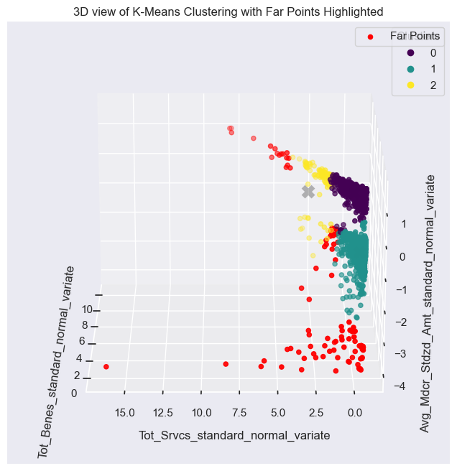
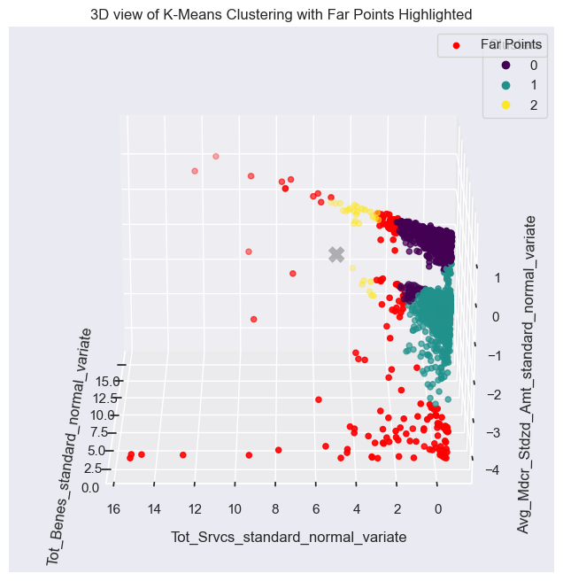
Outliers Before Data Poisoning
Outliers for First Half of the data (1988 Records)
Outliers for Complete Data (3977 Records)

Slide 4
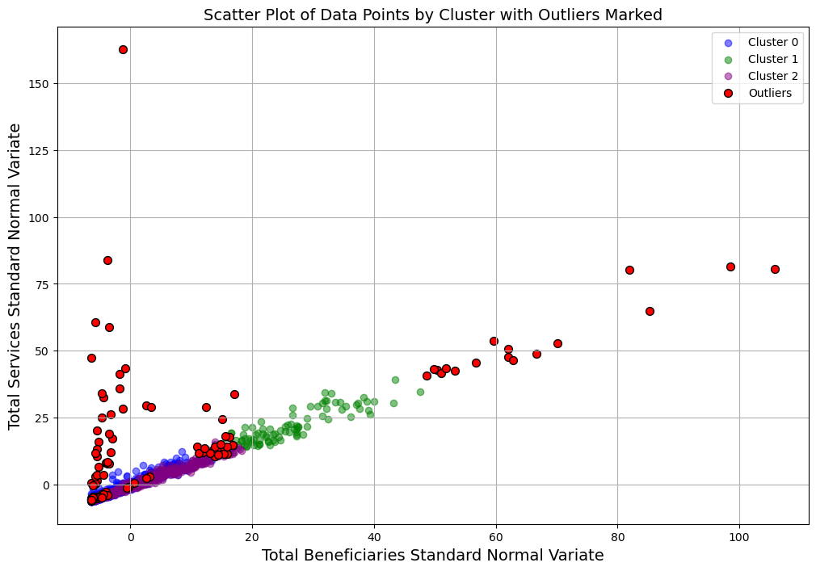
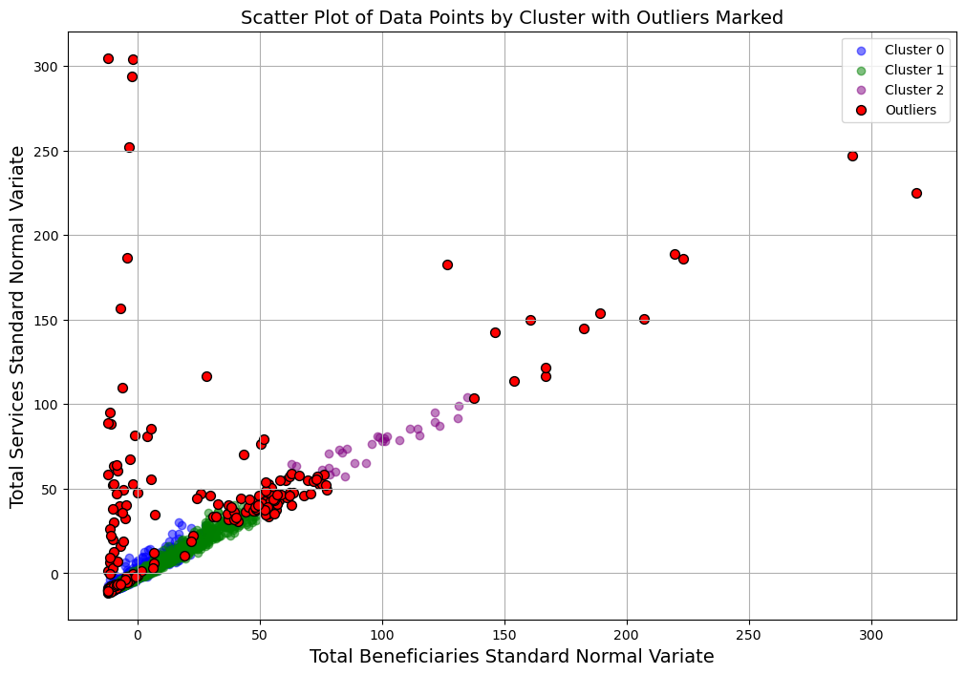
Outliers After Data Poisoning Structural Break Down With Low Extinct(Fraction of 0.1) and Medium Impact (Mean, STD – 20)
Outliers for First Half of the data (1988 Records)
Outliers for Complete Data (3977 Records)

Slide 5
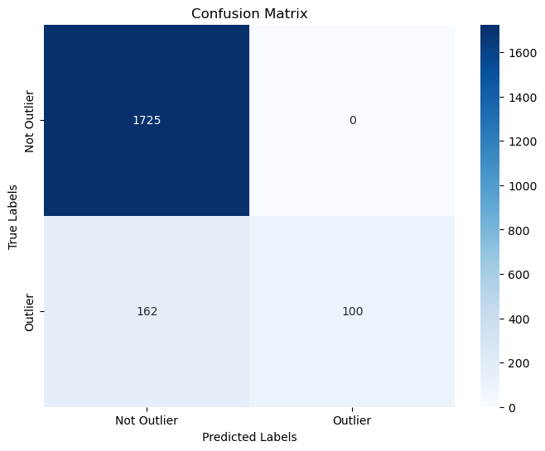

Confusion Matrix After Data Poisoning Structural Break Down With Low Extinct(Fraction of 0.1) and Medium Impact (Mean, STD – 20)
Confusion Matrix for First Half of the data
(1988 Records)
Confusion Matrix Outliers for Complete Data
(3977 Records)

Slide 6
Confusion Matrix
First Half Data
Full Data
Classification Count 0 TN 1725 1 FN 162 2 TP 100
Classification Count 0 TN 3482 1 FN 295 2 TP 199

Slide 7
Second question is the impact of defenses on attacked outliers

Slide 8
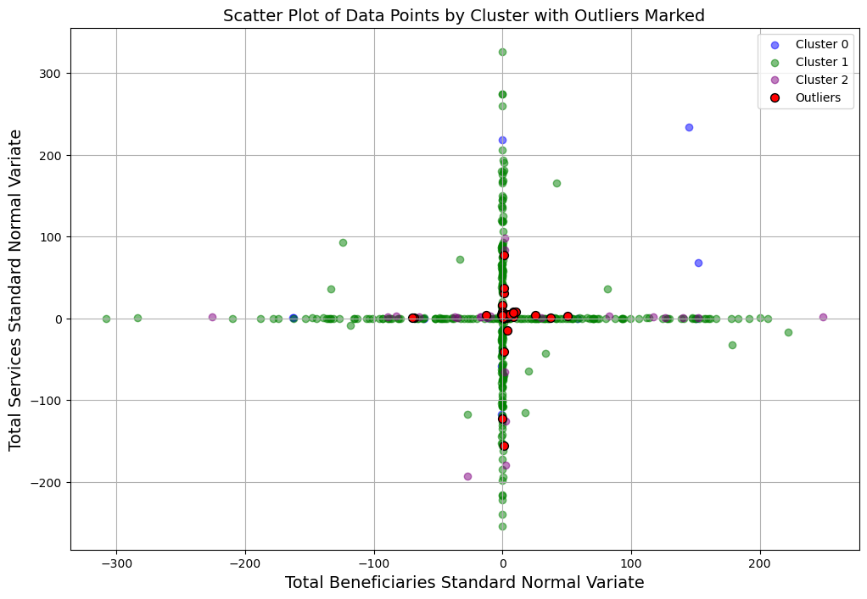
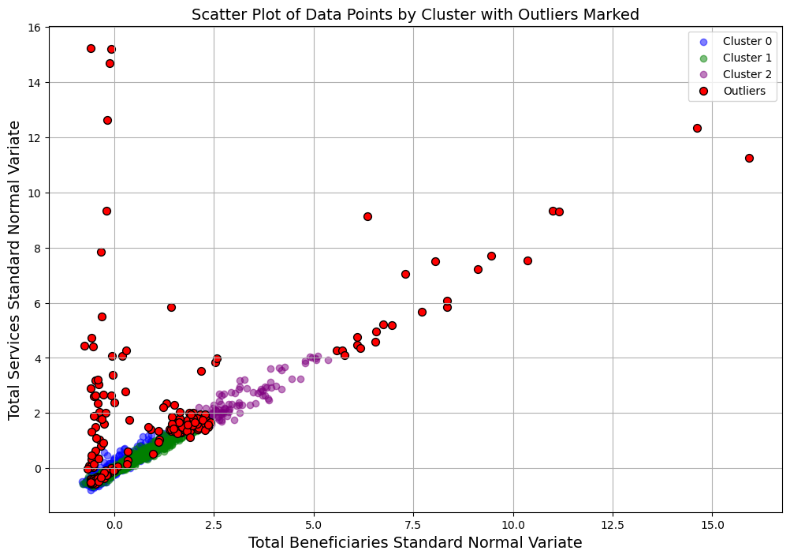
Outliers After Data Poisoning Noise With Fraction of 0.1 and Noise level of 100
Outliers for First Half of the data (1988 Records)
Outliers for Complete Data (3977 Records)

Slide 9
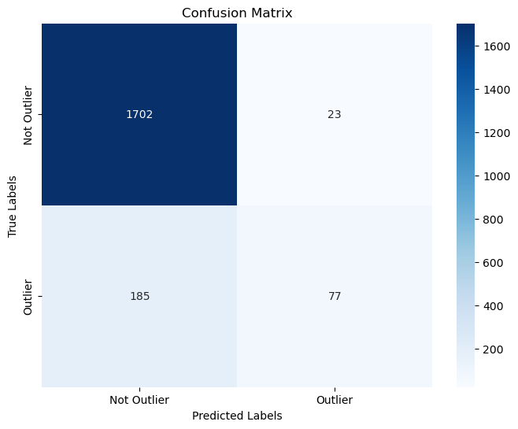
Confusion Matrix After Data Poisoning Noise With Fraction of 0.1 and Noise level of 100
Confusion Matrix for First Half of the data
(1988 Records)
Confusion Matrix Outliers for Complete Data
(3977 Records)

Slide 10
Confusion Matrix
First Half Data
Full Data
Classification Count 0 TN 1702 1 FN 185 2 TP 77 3 FP 23
Classification Count 0 TN 3482 1 FN 295 2 TP 199

Slide 11
Accessing all the layout options
This template includes over 20 unique layout options!
Click the dropdown arrow directly next to the ‘New Slide’ button to see more slide options not included in these samples.

Slide 12
DEPARTMENTAL PRESENTATIONS
Use the frame above to add your department logo

Slide 13
Defense
On defenses end, Th intial phase involve identifying the chnages in original data and identifying exact points of where changes happened. For this Noised data of First Half Dataset is taken as example.

Slide 14
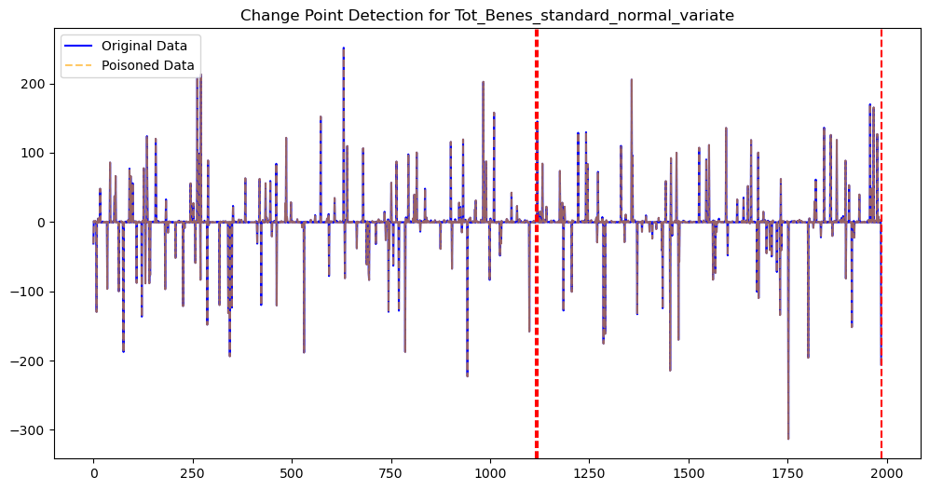
Change Point Detection represented with Red Dotted Lines, Along with the blues are original Data and the dotted orange is poisoned data.

Slide 15
Section Header
Want to add your own background image to a section header? Right-click the slide (careful to avoid the text boxes) and select ‘Format Background…’ to open the Format Pane on the right. Then hit the ‘Insert’ button and add any image from your computer.

Slide 16
“A bobcat will fight you with everything he has; with four claws, teeth, speed and brains.”
— Oscar Strahan

